Slide 1
School Law
Navigating Family Law issues that arise in your School

Slide 2
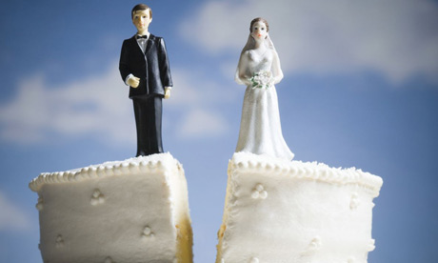
In Australia, every third marriage ends in divorce

Slide 3
During the past two decades, Australians started to marry less and divorce more
and
1 in 5 people will marry more than once

Slide 4
About one-third of children today are born outside the traditional marriage

Slide 5
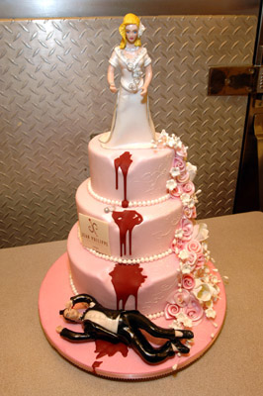
Men are more likely to die than to divorce (33.4% chance for a marriage to end in divorce, and 47% chance for a man to die while married)

Slide 6
Women are more likely to divorce than to die (33.4% chance for a marriage to end in divorce, and 22% chance for a woman to die while married)
This is due to longer life expectancy for women

Slide 7
Married people are twice as likely to have children than the ones in de-facto relationships

Slide 8
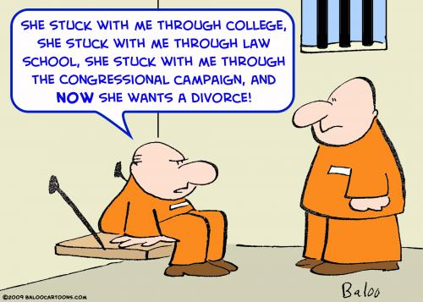
Women file more divorce applications than men

Slide 9
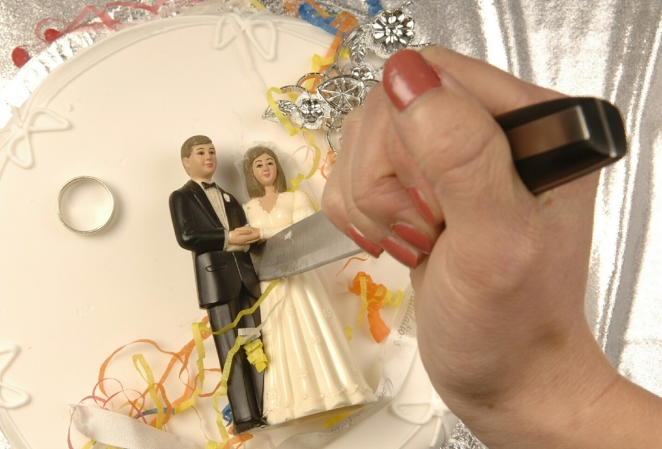
Most men divorce at the age 40-44, women at the age 35-39

Slide 10
Contact Us
Melbourne Level 6 530 Collins Street Melbourne VIC 3000 T: +61 3 9670 9111 F: +61 3 9605 0933 | Sydney Level 12 400 George Street Sydney NSW 2000 T: +61 2 8289 5800 F: +61 2 9247 1315 | Brisbane Level 14 145 Ann Street Brisbane QLD 4000 T: +61 7 3228 0400 F: +61 7 3012 8777
Canberra Level 9 121 Marcus Clarke Street Canberra ACT 2601 T: +61 2 6196 5200 F: +61 2 6196 5298 | Perth Level 2 225 St Georges Terrace Perth WA 6000 T: +61 8 6167 9800 F: +61 8 6167 9898
Disclaimer
This PowerPoint presentation is intended to provide only a limited analysis of the subject matter covered. It does not purport to be comprehensive, or to provide legal advice. Any views or opinions expressed are the views or opinions of the presenter, and not those of Mills Oakley as a Firm. Readers should satisfy themselves as to the correctness, relevance and applicability of any of its content, and should not act on any of it in respect of any specific problem or generally without first obtaining their own independent professional legal advice.
www.millsoakley.com.au

